Slide 1
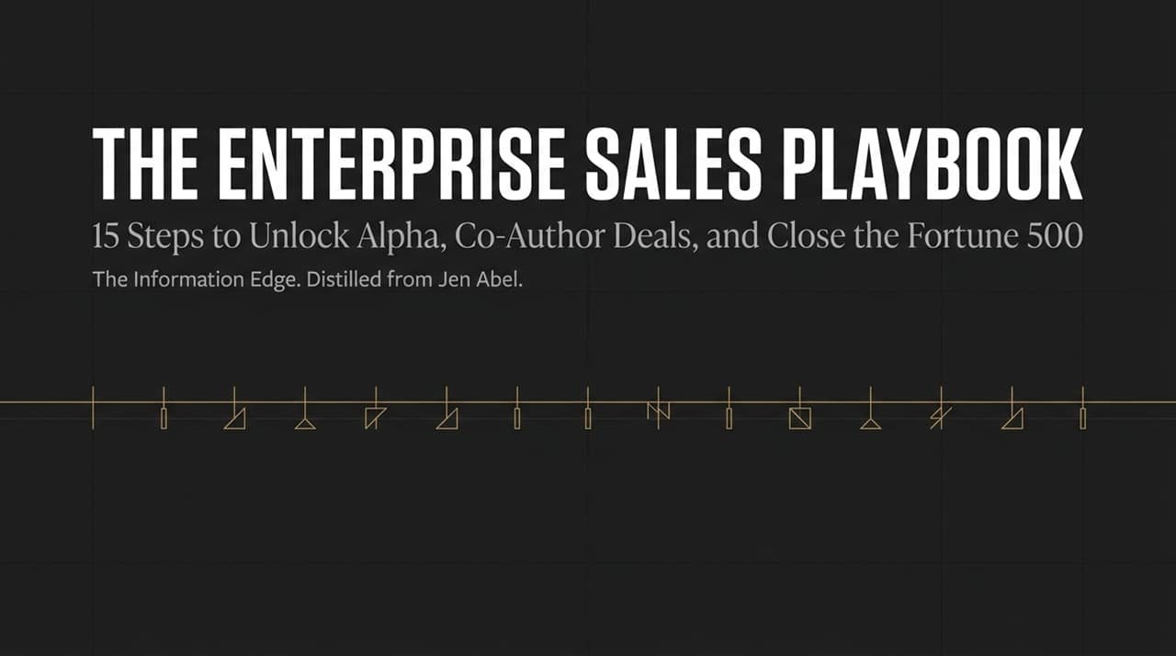
Notes:
Opening Anchor: "Welcome, everyone. Today we are dismantling the biggest lie in B2B sales: the idea that closing enterprise accounts is a linear, 5-step process."
Core Message: "Selling to the Fortune 500 isn't about running through a standard CRM stage sequence. It’s a 15-step psychological project management process. Most sellers fail because they rely on surface-level milestones, while master sellers win by controlling the hidden micro-steps."
Key Talking Points:
The Information Edge: In complex sales, whoever collects the most context and internal alignment wins.
Co-Authoring vs. Pitching: We are moving away from 'vendor pitching' and toward co-authoring deal structures directly with our buyers.
What to Expect: Over the next 15 slides, we’ll break down every critical phase—from initial entry and no-demo discovery to paper-process reverse engineering.
https://youtube.com/watch?v=YS9In813jJ0

Slide 2
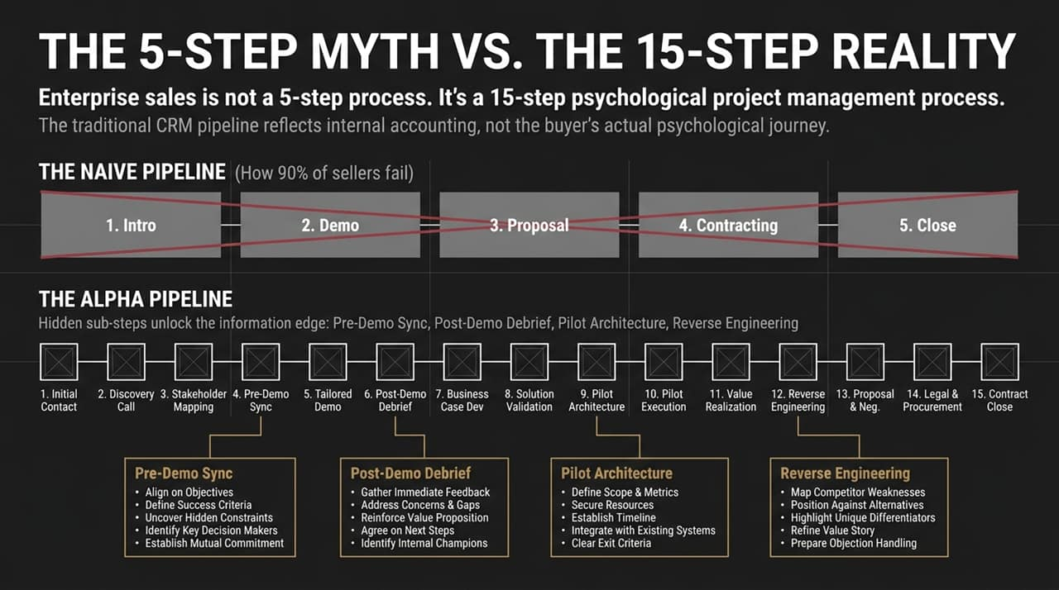
Notes:
Opening Anchor: "Take a look at the top graphic. That’s how 90% of reps view their pipeline—and why 90% of reps miss quota in enterprise environments."
Core Message: "The traditional 5-stage pipeline—Intro, Demo, Proposal, Contracting, Close—is designed for internal accounting, not buyer psychology."
Key Talking Points:
The Naive Funnel: A standard funnel assumes buyers move neatly from stage to stage. In reality, large deals stall out because unseen organizational friction sits between those stages.
The Alpha Pipeline: Notice the hidden sub-steps on the bottom pipeline: Pre-Demo Syncs, Post-Demo Debriefs, Pilot Architecture, and Reverse Engineering.
The Nuance: Skipping from Discovery straight to a Demo without a Pre-Demo Sync guarantees an unaligned presentation. The Alpha process builds safety, consensus, and momentum at every single micro-step.

Slide 3
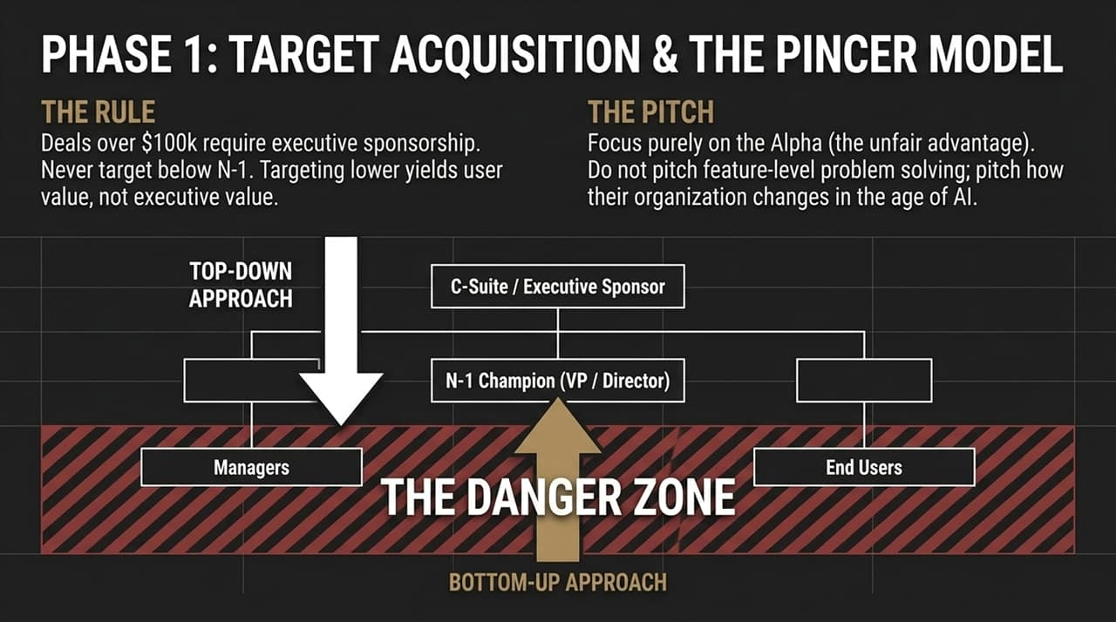
Notes:
Opening Anchor: "If you are selling deals valued at over $100k, you cannot start at the manager level."
Core Message: "Focusing on bottom-up selling traps you in 'The Danger Zone'. Managers buy feature-level utility; executives buy organizational transformation and competitive edge—what we call 'Alpha'."
Key Talking Points:
The $100k Rule: Deals of this scale mandate C-suite or top-tier executive sponsorship. Never anchor lower than N-1 (VPs/Directors).
The Pincer Model: Execute a top-down and bottom-up alignment simultaneously. Secure high-level strategic buy-in from the C-Suite while arming your N-1 Champion with the exact data needed to justify the mandate down to managers.
The Pitch Shift: Stop selling problem-solving features. Sell how their entire operating model evolves in the age of AI.

Slide 4
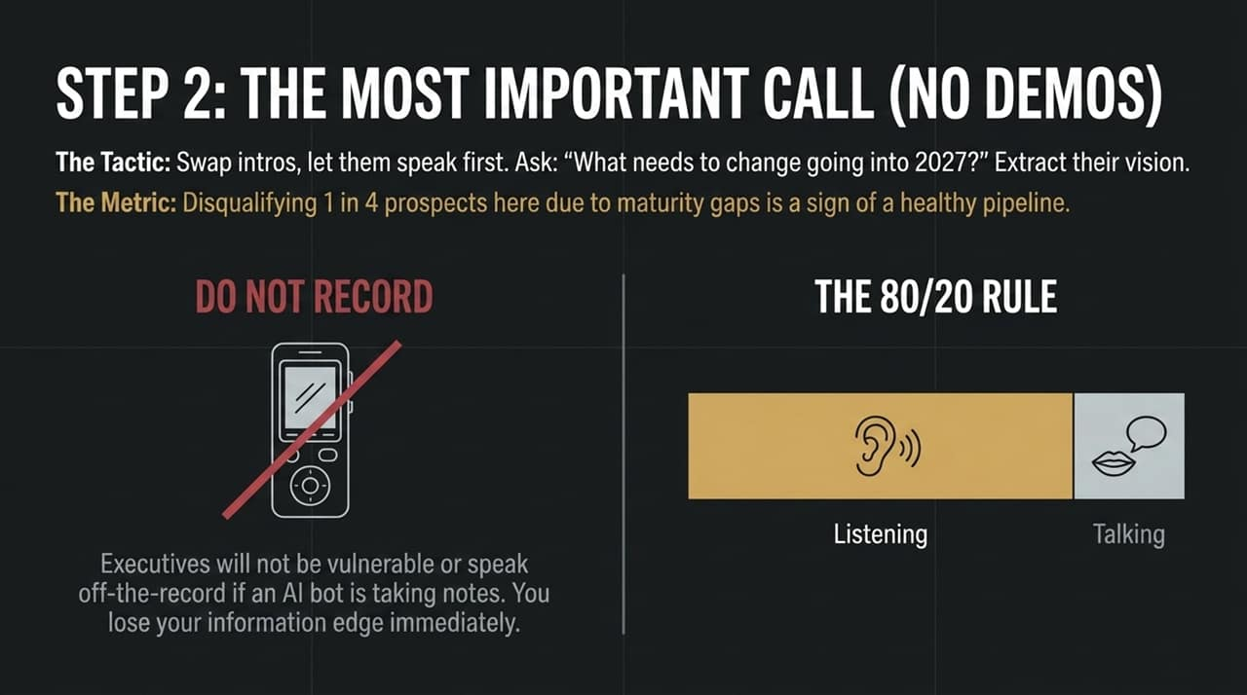
Notes:
Opening Anchor: "The single most dangerous thing you can do on a first call with an executive is fire up a product demo."
Core Message: "First discovery calls must be 80% listening and 20% talking. The goal is extraction, not demonstration."
Key Talking Points:
No AI Recorders: Ban AI note-taking bots on these initial executive calls. Executives will not speak candidly or share vulnerable internal politics if a bot is recording them. You immediately destroy your information edge.
The Master Question: Swap intros quickly and ask: 'What needs to change going into 2027?' Let them articulate their macro vision while you take raw notes.
Disqualification Metric: If 1 out of 4 prospects isn't disqualified here due to maturity gaps, your discovery standards are too low.

Slide 5
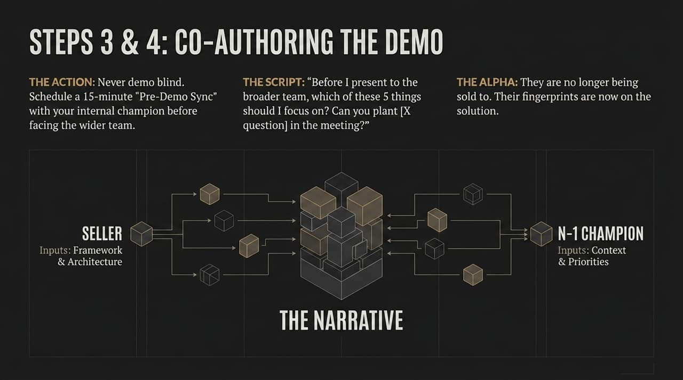
Notes:
Opening Anchor: "Never step into a group demo blind. If you show up to a multi-stakeholder call without pre-aligning, you are gambling."
Core Message: "We use a 15-minute Pre-Demo Sync with our N-1 Champion to co-author the presentation before the rest of their team sees it."
Key Talking Points:
The Script: Ask your champion: 'Before I present to the broader team, which of these 5 core areas should I focus on? Can you plant [X question] during the session?'
Psychological Shift: By combining your framework with their internal context, you build a shared narrative.
The Result: The champion no longer feels like a prospect being pitched; they become a co-author whose personal reputation is tied to the success of the pitch.

Slide 6
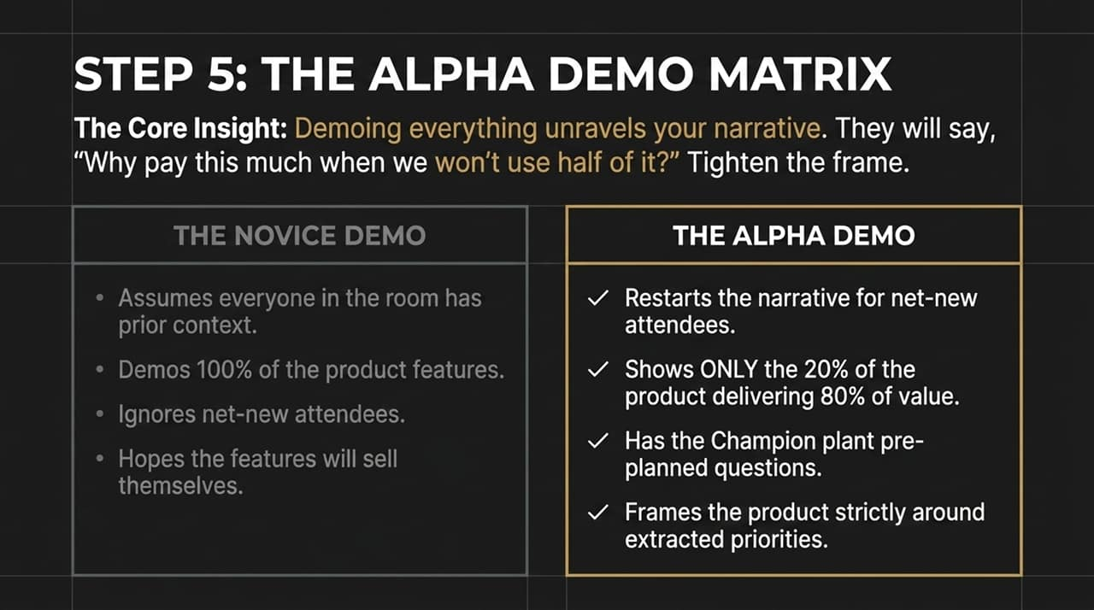
Notes:
Opening Anchor: "The quickest way to derail an enterprise deal is to give a tour of every feature in your software."
Core Message: "Showing 100% of your product leads to objection-building. Buyers look at unused features and think, 'Why pay for all of this when we only need a fraction?'"
Key Talking Points:
Novice vs. Alpha Demo: Novice sellers assume context, show everything, and hope features sell themselves. Alpha sellers restart narrative context for new attendees and show only the 20% of features that deliver 80% of the strategic value.
Planted Dynamics: Leverage the questions planted with your champion during Step 4 to guide the room organically.
Tight Framing: Frame every screen exclusively around the explicit business priorities extracted during discovery.

Slide 7
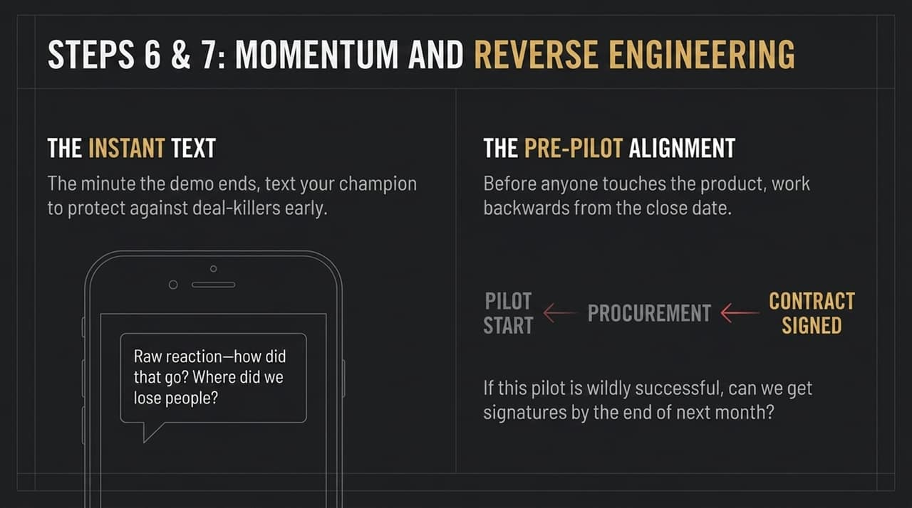
Notes:
Opening Anchor: "The gap between the end of a demo and the next step is where enterprise deals go to die."
Core Message: "Maintain absolute momentum through immediate debriefs and working backward from a hard close date."
Key Talking Points:
The Instant Text: The second the demo call ends, send a casual text to your champion: 'Raw reaction—how did that go? Where did we lose people?' Catch negative sentiment before it turns into internal consensus.
Reverse Engineering: Before launching a pilot or evaluation, set the target signature date first.
The Pre-Pilot Ask: Ask directly: 'If this evaluation meets every criteria we set, can we realistically have contracts signed by the end of next month?' Map procurement and legal backwards from that date.

Slide 8
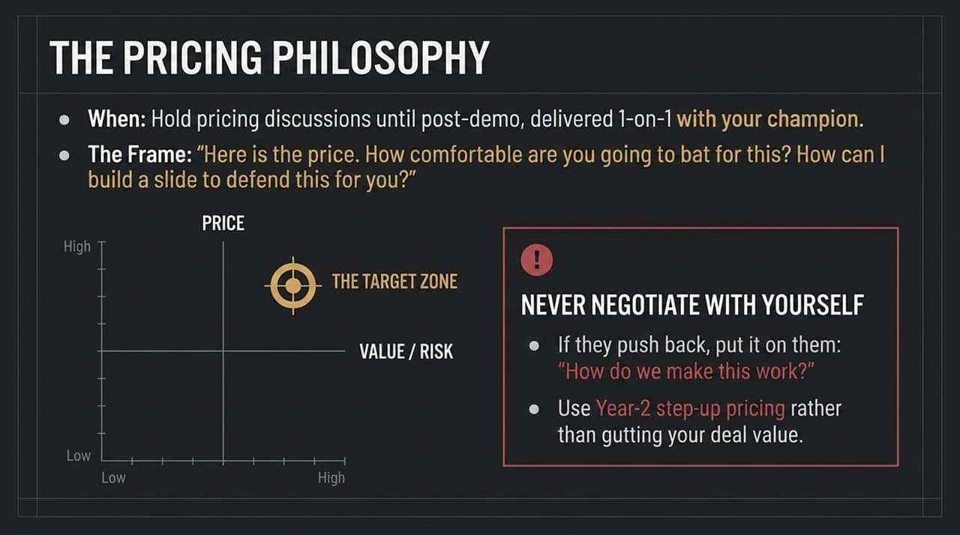
Notes:
Opening Anchor: "Pricing should never be a slide dumped at the end of a group demo presentation."
Core Message: "Deliver pricing 1-on-1 with your champion post-demo, positioning yourself in the high-value, high-price target quadrant."
Key Talking Points:
Co-Defending Price: Present the number and ask: 'How comfortable are you going to bat for this? How can I help you build a slide to defend this internally?'
Never Negotiate With Yourself: When buyers push back on price, do not drop your rates immediately. Turn it back to them: 'How do we make this work within your current parameters?'
Year-2 Step-Up: If budget constraints are real, preserve total deal value by using Year-2 step-up pricing rather than discounting Year 1.

Slide 9
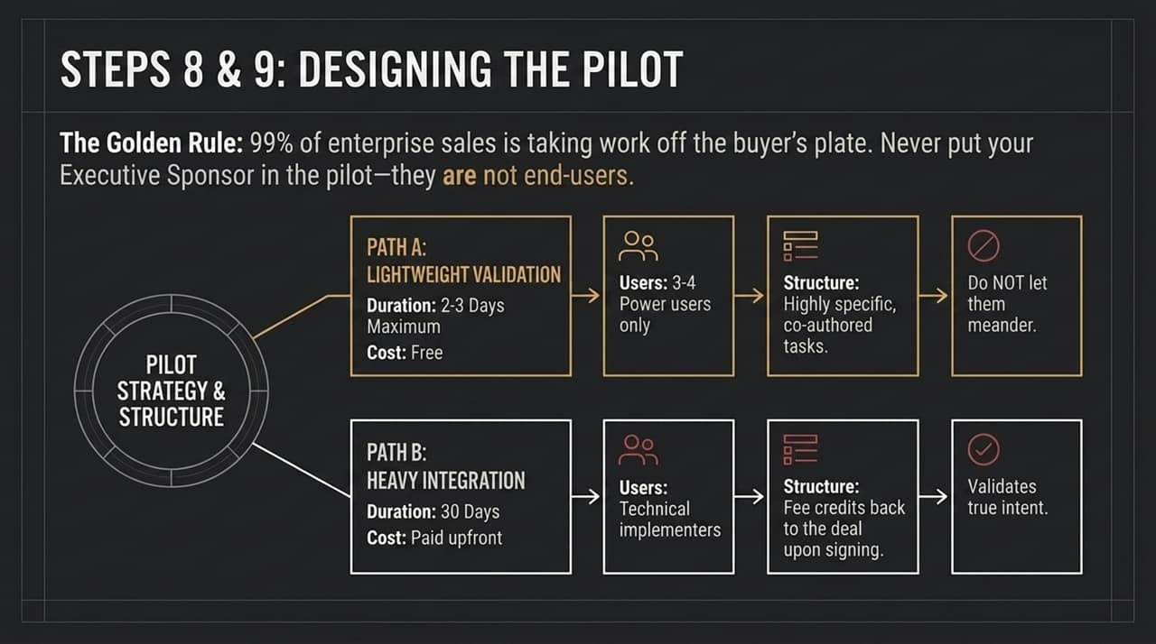
Notes:
Opening Anchor: "Pilots are not trial periods for users to click around and explore; they are tightly controlled validation sprints."
Core Message: "Never put an Executive Sponsor in a pilot—they aren't end-users. Protect their time and offer two strict paths."
Key Talking Points:
Path A (Lightweight Validation): 2 to 3 days maximum, free of cost, capped at 3–4 power users focused strictly on co-authored, specific tasks. Do not allow meander.
Path B (Heavy Integration): 30 days, paid upfront, involving technical implementers. Offer to credit the pilot fee back toward the total contract upon signature. Paid pilots instantly validate true buying intent.

Slide 10
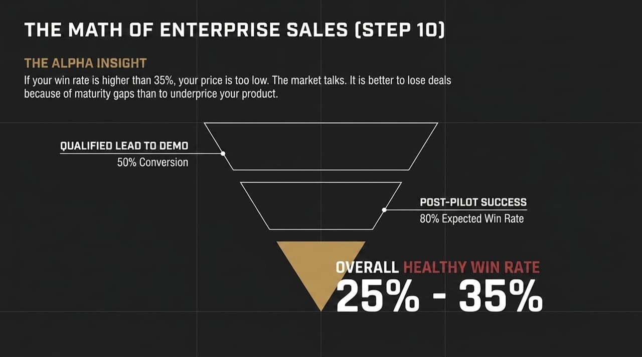
Notes:
Opening Anchor: "If your win rate is 70% or 80%, stop celebrating—it means your price is significantly too low."
Core Message: "A healthy, highly profitable enterprise sales motion operates at a 25% to 35% overall win rate."
Key Talking Points:
Conversion Benchmarks: Aim for a 50% conversion from Qualified Lead to Demo. Once a pilot is successfully executed, your closing rate should be ~80%.
Market Feedback: High win rates mean you aren't pushing price elasticity. It is far better to lose deals due to prospect maturity gaps than to sell enterprise-grade solutions at bargain prices.

Slide 11
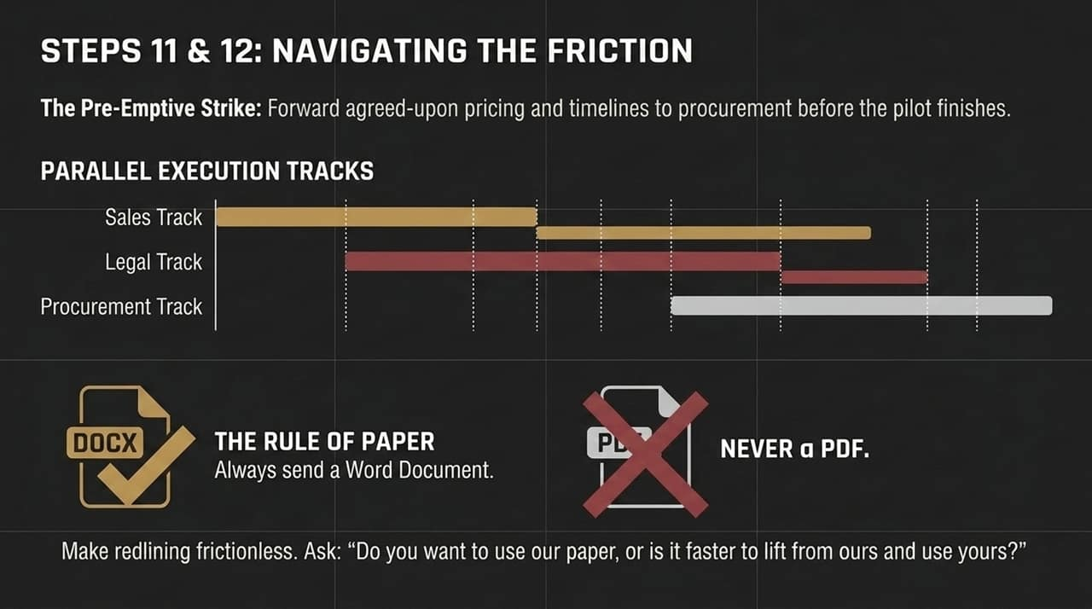
Notes:
Opening Anchor: "Waiting for a pilot to finish before starting legal and procurement is the single biggest cause of deal slippage."
Core Message: "Run sales, legal, and procurement tracks in parallel, and eliminate friction with frictionless document formats."
Key Talking Points:
Parallel Execution Tracks: Forward pricing, security documentation, and draft terms to procurement while the pilot is underway.
The Rule of Paper: Never send contract terms as a PDF; always send an editable Word Document (.docx). PDF contracts force legal teams to recreate documents, adding weeks of delay.
Frictionless Positioning: Ask: 'Do you want to use our paper, or is it faster to lift our terms into your standard template?'

Slide 12
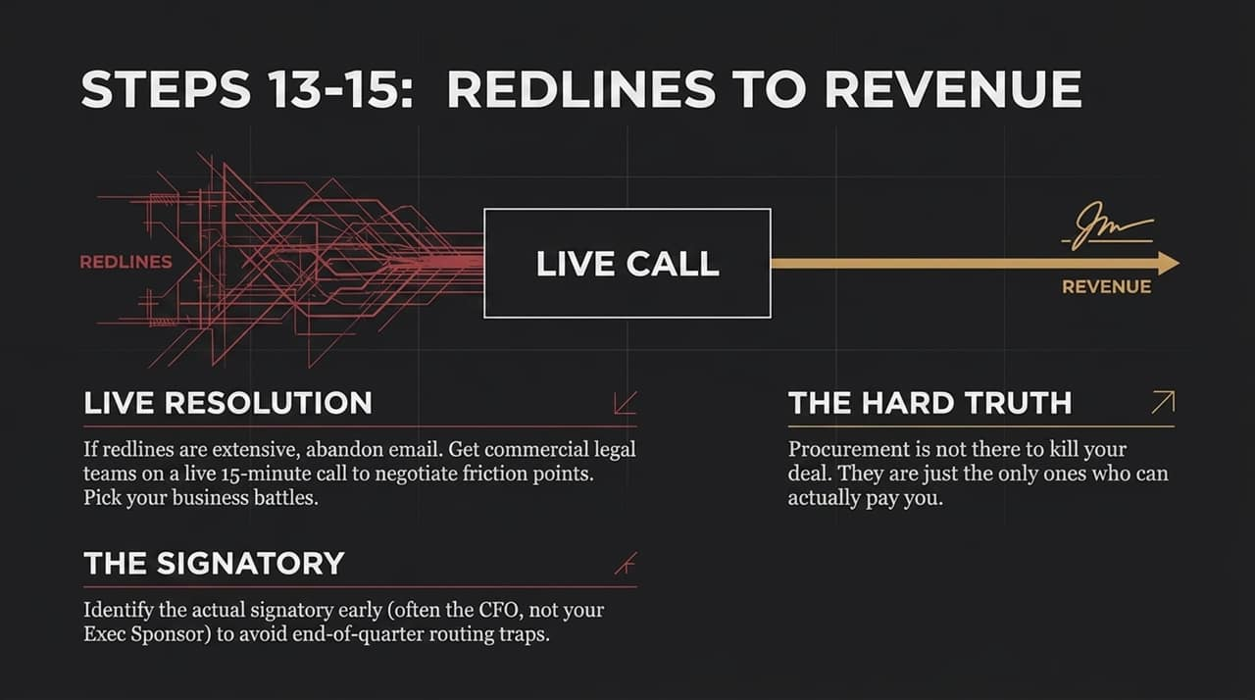
Notes:
Opening Anchor: "Email threads with legal departments are where momentum goes to die."
Core Message: "Bypass endless email redlines with live calls, and always identify the true financial signatory early."
Key Talking Points:
Live Redline Resolution: If a contract returns with heavy redlines, get counsel from both sides on a 15-minute live call to negotiate terms in real-time. Pick your battles on secondary clauses.
Identifying the Signatory: Confirm early who holds final signing authority. It is frequently the CFO or VP of Finance, not your champion.
Reframe Procurement: Procurement is not the enemy. They are simply the only group in the enterprise authorized to release funds to you.

Slide 13
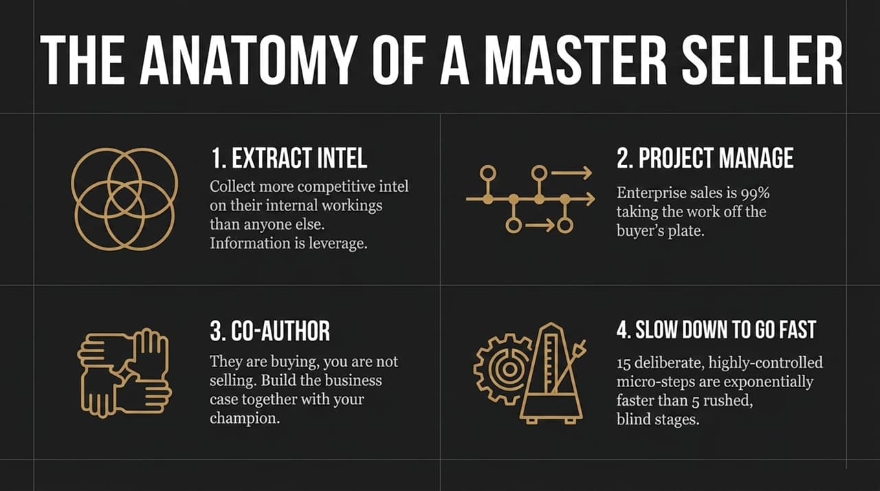
Notes:
Opening Anchor: "To summarize what separates average reps from top 1% performers, let's look at the four pillars of master sellers."
Core Message: "Mastery is about information control, process management, and custom experiences."
Key Talking Points:
1. Extract Intel: Gather more internal operational leverage than anyone else. Information is control.
2. Project Manage: Take 99% of the administrative and organizational burden off your buyer's desk.
3. Co-Author: Build the internal business case alongside your champion.
4. Slow Down to Go Fast: Executing 15 controlled micro-steps prevents deal stalls, making it vastly faster than rushing through 5 blind stages.

Slide 14
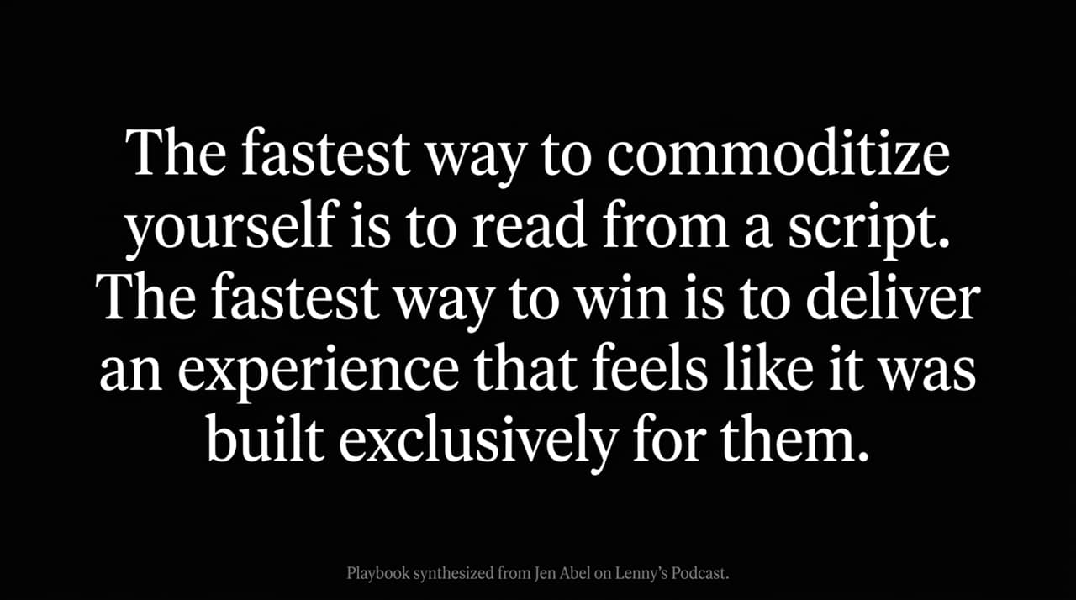
Notes:
Opening Anchor: "This slide synthesizes our entire 3-Phase framework onto a single operational blueprint."
Core Message: "Use this overview to audit where your current pipeline deals are stalling out."
Key Talking Points:
Phase 1 (Entry & First Contact): Drive initial engagement using 3-sentence Alpha pitches, executing the Pincer Model, and enforcing No-Demo first calls.
Phase 2 (Collaborative Evaluation): Maintain control by co-authoring demos, focusing only on the 20% core value, and running tightly time-boxed pilots.
Phase 3 (Navigating Paper): Parallel-track procurement, reverse-engineer timeline risks, and use editable docs to clear legal hurdles.

Slide 15
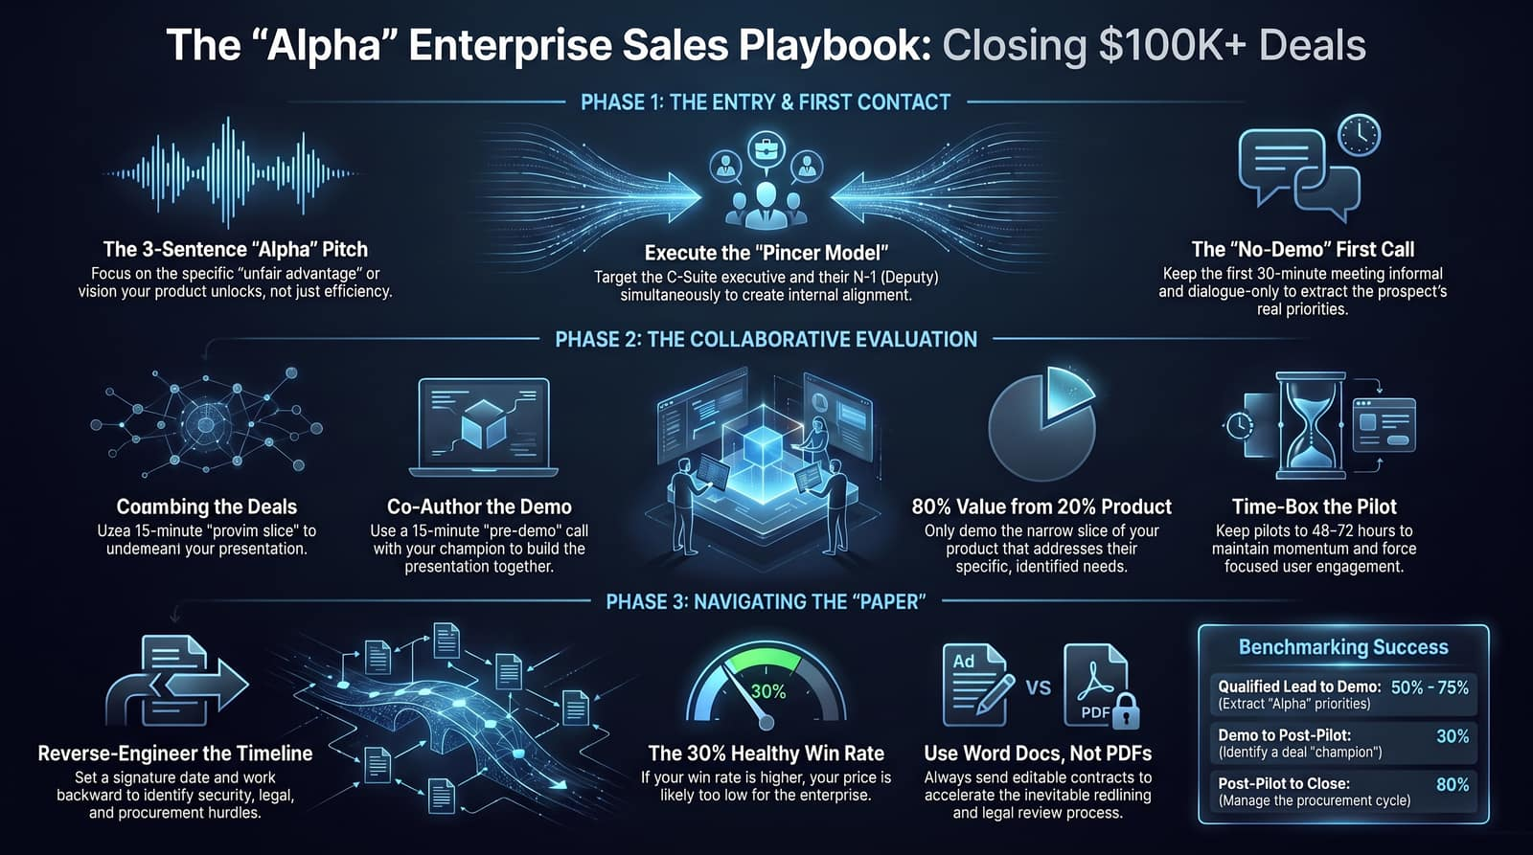
Notes:
Opening Anchor: "Let's wrap up with the exact conversion metrics and execution principles that govern this system."
Core Message: "Track your pipeline against these proven conversion benchmarks to maintain accurate forecasting."
Key Talking Points:
Conversion Ratios: Expect 50% from Qualified Lead to Demo, 75% from Demo to Pilot, and 80% from Post-Pilot to Signed Contract.
Target Win Rate: Keep your overall win rate bounded between 25% and 35%. Higher indicates underpricing; lower indicates poor qualification.
Final Call to Action: Stop treating enterprise sales like a transactional pitch. Run it like an executive management project, build leverage, and co-author every deal to close.

